Slide 1



Vehicle Maintenance System
FRONTEND
Torque Titans
Slade Sahoye
Xuan Khai Dao
Homer Bernardino
Carlos Cueto
Mentor: Shadad Shariatmadari

Slide 2

OUR TEAM MEMBERS
BACK TO OVERVIEW
Slade Sahoye
Homer Bernardino
Front End
Back End
Xuan Khai Dao
Carlos Cueto
Front End
Back End
Back End

Slide 3


Introduction
Goal:
Develop a system to manage the car maintenance process at a garage – including customer information, vehicles, technicians, and services performed
Key Features:
Manage customer and vehicle information
Track services and progress
User role management (Admin / Technician)
Quick statistics and reporting
Target Users:
Garage Administrator
Maintenance Mechanic

Slide 4


Business Logic
Business Logic
The layer that handles requests and coordinates data between the user interface and the database
Main Features:
User authentication (login, role-based access)
Data management (add, edit, delete, search customers/vehicles/services)
Display & statistics (services, tasks, vehicle details)
Workflow:
Receive request → Process (Controller) → Query (DAO) → Update UI
Core Values:
Accuracy, flexibility, efficiency

Slide 5


Project Timeline
Split into five phases
Phase 1: UI and initial wireframe planning
Phase 2-4: Progress on application (setting up app, creating controllers, design, integration with backend)
Final Phase: Final Testing and Submission

Slide 6
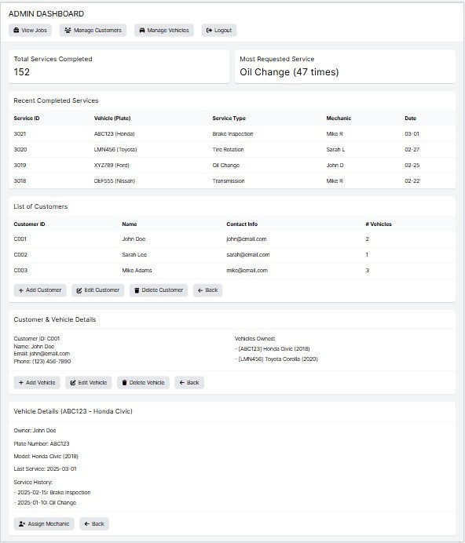
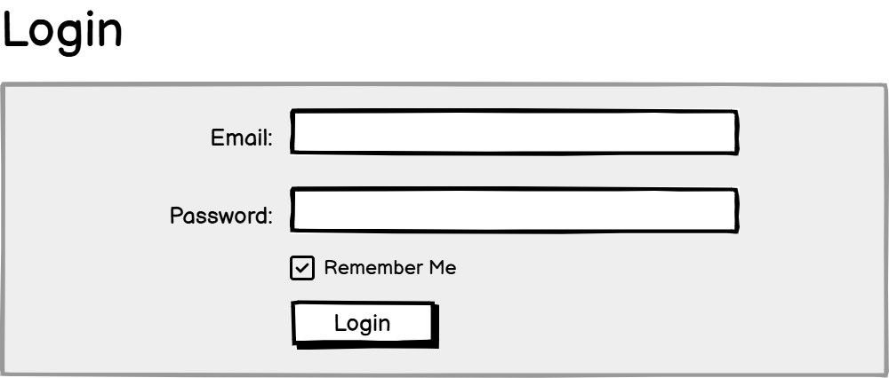
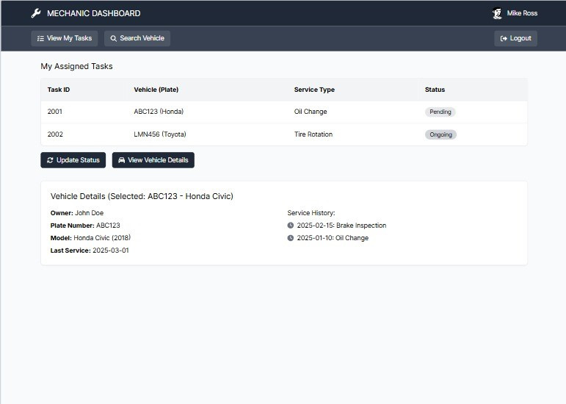

Slide 7


Frontend
Login
Admin Dashboard
Mechanic Dashboard

Slide 8
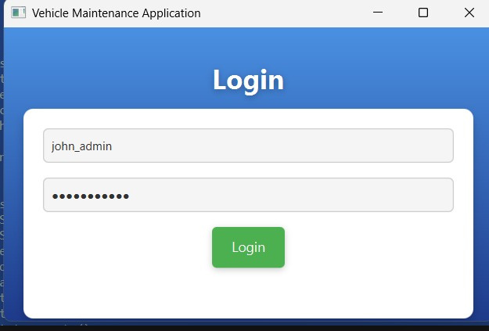
Login Screen
User authentication based on username and password
Redirect users to the appropriate interface based on their role (Admin Dashboard or Mechanic Dashboard)

Slide 9
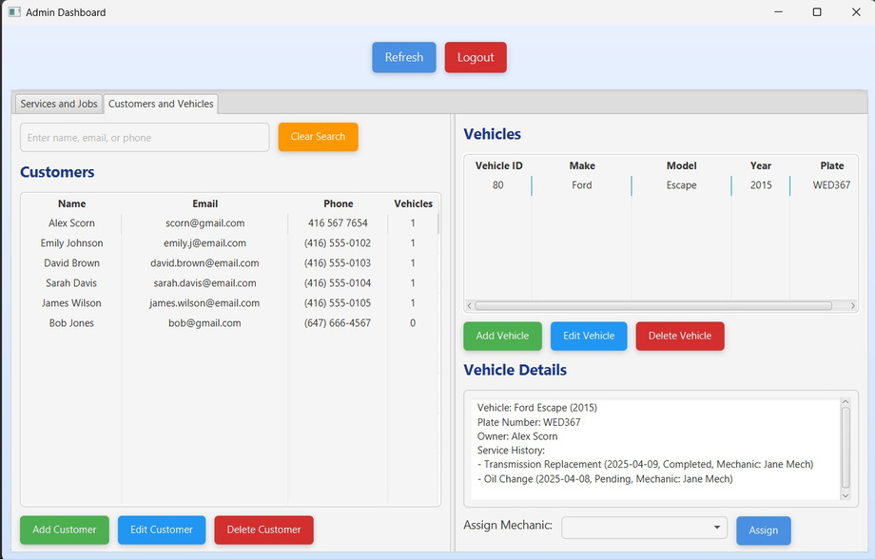
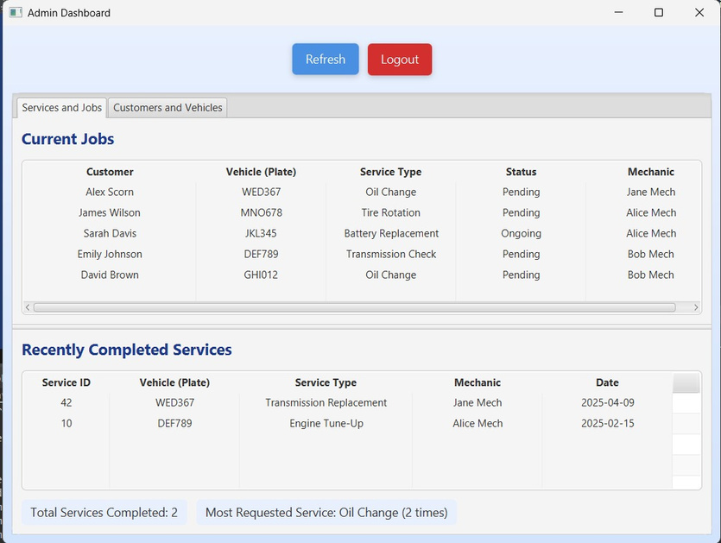
Admin Dashboard
Provides an overview of vehicle maintenance activities
Allows administrators to perform data management operations (add, edit, delete)
Supports mechanic assignment and job status tracking

Slide 10
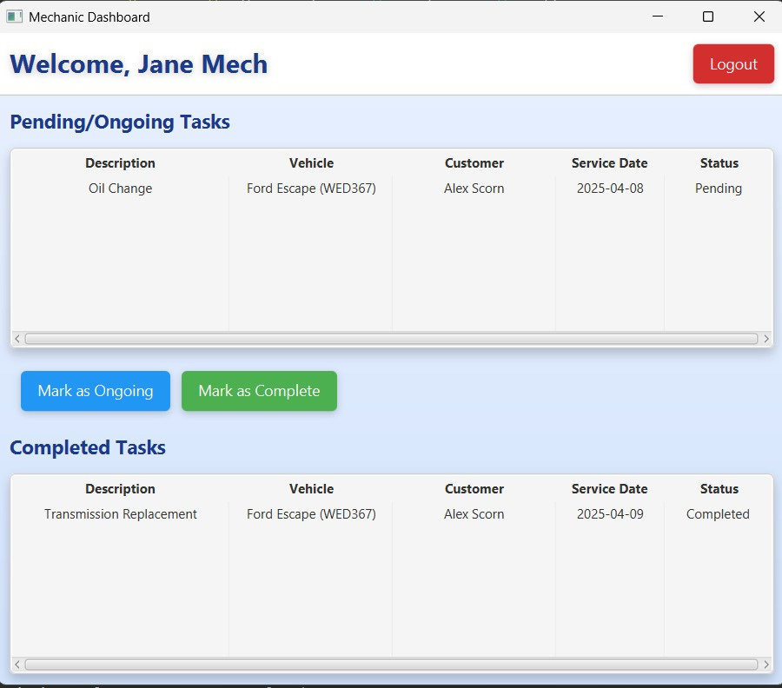
Mechanics Dashboard
Displays a list of assigned maintenance tasks
Allows mechanics to update job status (Pending, Ongoing)
Provides detailed information about the vehicle related to the task

Slide 11
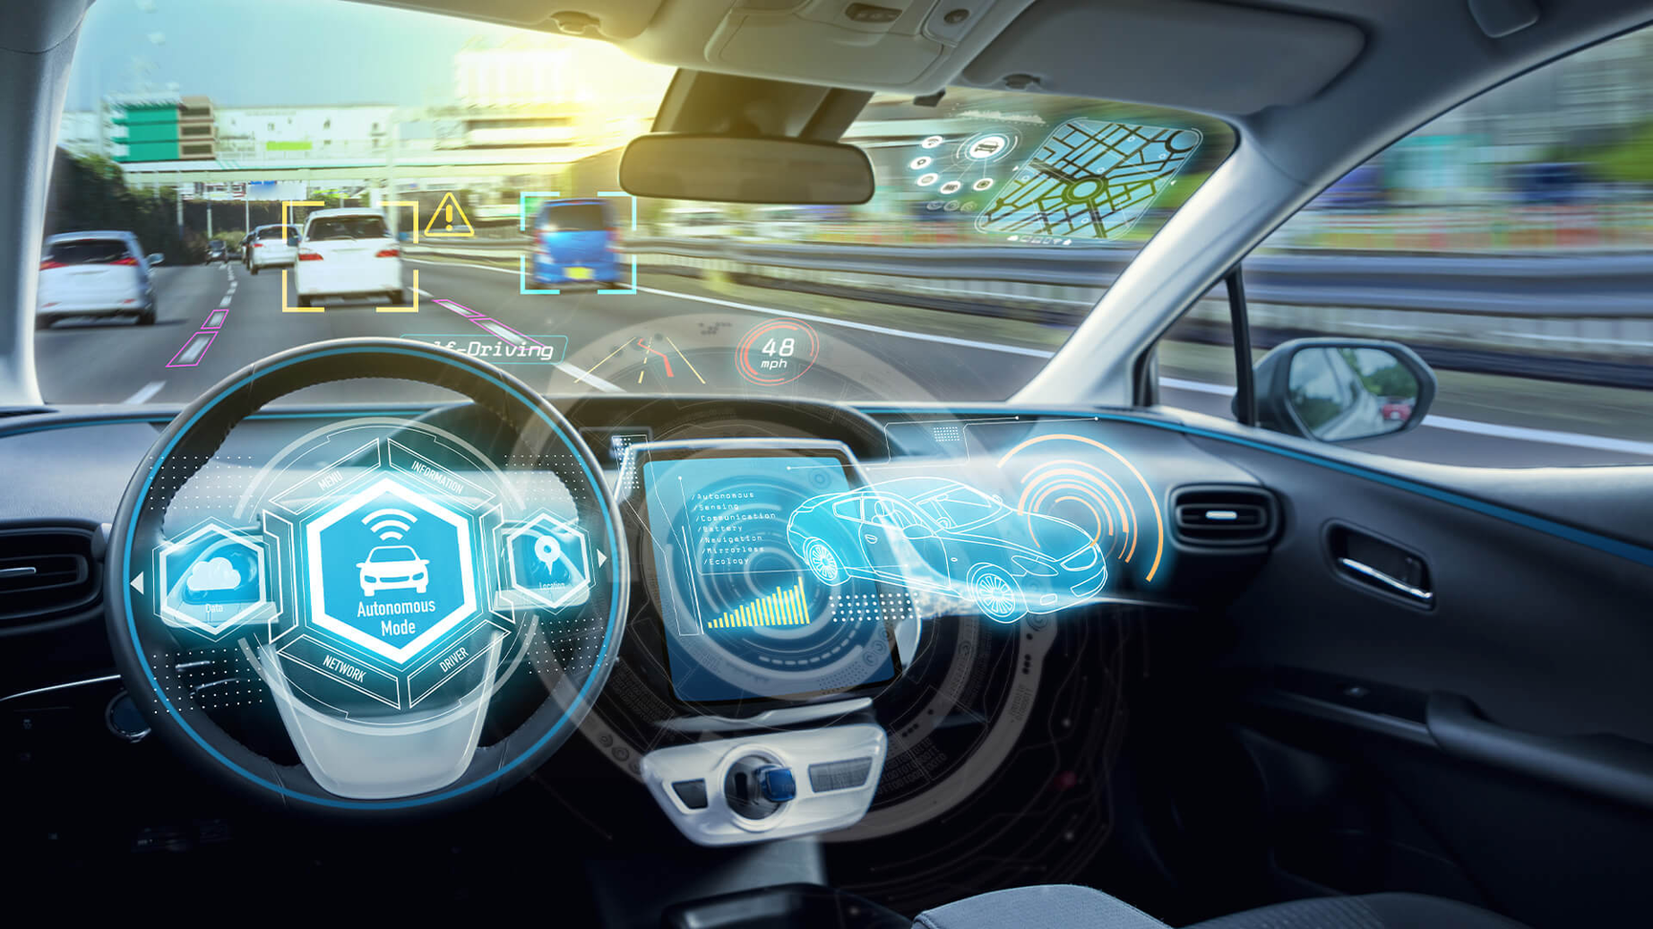
THE CHALLENGES
OF PROJECT
Create role-specific interfaces: Designing the Admin Dashboard with multiple complex tabs, while the Mechanic Dashboard needs to be simple, displaying only assigned tasks
Real-time data updates: Ensuring TableView (e.g., customersTable, tasksTable) automatically refreshes when the Admin adds/removes customers or the Mechanic updates task status
Complex user event management: Handling multiple simultaneous interactions, such as selecting a customer to view their vehicle, selecting a vehicle for details, or searching in the Admin Dashboard

Slide 12
Vehicle Maintenance & Service Management System
BACKEND
Torque Titans

Slide 13


Vehicle Maintenance & Service Management System
01
02
ORACLE SQL DEVELOPER
ERD (ENTITY RELATIONSHIP DIAGRAM)
The backbone technology enabling robust database management
A structured representation of system entities and their relationships.
03
04
STORED PROCEDURE
CLIENT BENEFITS AND BUSINESS IMPACT
Automated processes delivering advanced functionality
Streamlines operations, boosts efficiency, and enhances profitability.

Slide 14
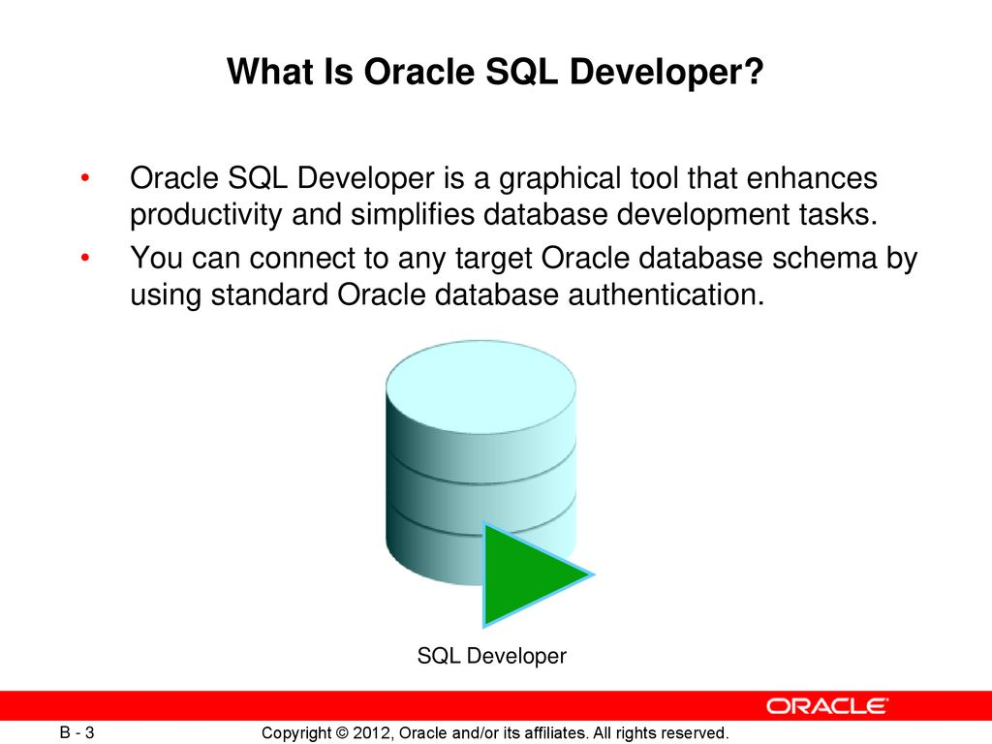
FEATURES
Data Storage: Manages large-scale vehicle and maintenance records.
PL/SQL: Automates processes with stored procedures and triggers.
Query Execution: Retrieves service history and schedules.
Security: Protects sensitive data with access controls.
Integration: Ensures smooth frontend-backend interaction.

Slide 15
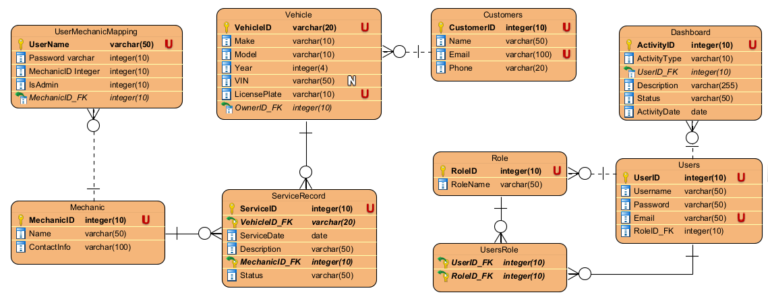
ENTITY RELATIONSHIP DIAGRAM

Slide 16

Stored Procedure : Manage Customer
Purpose
Streamlines customer data management (Create, Read, Update, Delete).
Benefits
Automates repetitive tasks, reducing manual effort.
Ensures data accuracy and consistency in operations.
Enhances system efficiency, improving user experience.

Slide 17

Code : ManageCustomer
CREATE OR REPLACE EDITIONABLE PROCEDURE "MANAGECUSTOMER" (
p_Operation IN VARCHAR2,
p_CustomerID IN NUMBER,
p_Name IN VARCHAR2,
p_Email IN VARCHAR2,
p_Phone IN VARCHAR2
) AS
BEGIN
IF p_Operation = 'CREATE' THEN
INSERT INTO Customers (CustomerID, Name, Email, Phone)
VALUES (Customers_Seq.NEXTVAL, p_Name, p_Email, p_Phone);
ELSIF p_Operation = 'UPDATE' THEN
UPDATE Customers
SET Name = p_Name,
Email = p_Email,
Phone = p_Phone
WHERE CustomerID = p_CustomerID;
ELSIF p_Operation = 'DELETE' THEN
DELETE FROM Customers
WHERE CustomerID = p_CustomerID;
ELSE
RAISE_APPLICATION_ERROR(-20001, 'Invalid operation: ' || p_Operation);
END IF;
COMMIT;
EXCEPTION
WHEN OTHERS THEN
ROLLBACK;
RAISE_APPLICATION_ERROR(-20002, 'Error in ManageCustomer: ' || SQLERRM);
END ManageCustomer;
/

Slide 18

Stored Procedure : Manage Mechanics
Purpose
Manages mechanic information through CRUD actions, ensuring data integrity.
Benefits
Simplifies the administration of mechanic records, enhancing operational flow.

Slide 19
Code : ManageMechanics
REM INSERTING into EXPORT_TABLE
SET DEFINE OFF;
PROCEDURE "MANAGEMECHANICS" (
p_action IN VARCHAR2,
p_MechanicID IN NUMBER DEFAULT NULL,
p_Name IN VARCHAR2 DEFAULT NULL,
p_ContactInfo IN VARCHAR2 DEFAULT NULL,
p_result OUT SYS_REFCURSOR
) AS
v_mechanic_id NUMBER;
BEGIN
IF UPPER(p_action) = 'CREATE' THEN
SELECT mechanic_seq.NEXTVAL INTO v_mechanic_id FROM DUAL;
INSERT INTO Mechanic (MechanicID, Name, ContactInfo)
VALUES (v_mechanic_id, p_Name, p_ContactInfo);
OPEN p_result FOR
SELECT MechanicID, Name, ContactInfo
FROM Mechanic
WHERE MechanicID = v_mechanic_id;
COMMIT;
DBMS_OUTPUT.PUT_LINE('Mechanic created successfully with ID: ' || v_mechanic_id);
ELSIF UPPER(p_action) = 'READ' THEN
OPEN p_result FOR
SELECT MechanicID, Name, ContactInfo
FROM Mechanic
WHERE MechanicID = NVL(p_MechanicID, MechanicID);
ELSIF UPPER(p_action) = 'UPDATE' THEN
UPDATE Mechanic
SET Name = NVL(p_Name, Name),
ContactInfo = NVL(p_ContactInfo, ContactInfo)
WHERE MechanicID = p_MechanicID;
IF SQL%ROWCOUNT > 0 THEN
OPEN p_result FOR
SELECT MechanicID, Name, ContactInfo
FROM Mechanic
WHERE MechanicID = p_MechanicID;
COMMIT;
DBMS_OUTPUT.PUT_LINE('Mechanic updated successfully.');
ELSE
OPEN p_result FOR SELECT * FROM Mechanic WHERE 1=0;
DBMS_OUTPUT.PUT_LINE('No mechanic found with the provided MechanicID.');
END IF;
ELSIF UPPER(p_action) = 'DELETE' THEN
DELETE FROM Mechanic
WHERE MechanicID = p_MechanicID;
IF SQL%ROWCOUNT > 0 THEN
OPEN p_result FOR SELECT * FROM Mechanic WHERE 1=0;
COMMIT;
DBMS_OUTPUT.PUT_LINE('Mechanic deleted successfully.');
ELSE
OPEN p_result FOR SELECT * FROM Mechanic WHERE 1=0;
DBMS_OUTPUT.PUT_LINE('No mechanic found with the provided MechanicID.');
END IF;
ELSE
OPEN p_result FOR SELECT * FROM Mechanic WHERE 1=0;
DBMS_OUTPUT.PUT_LINE('Invalid action. Please use CREATE, READ, UPDATE, or DELETE.');
END IF;
EXCEPTION
WHEN OTHERS THEN
ROLLBACK;
DBMS_OUTPUT.PUT_LINE('Error: ' || SQLERRM);
OPEN p_result FOR SELECT * FROM Mechanic WHERE 1=0;
RAISE;
END;

Slide 20

Stored Procedure : Manage Service Record
Purpose
Oversees service records—vehicle servicing details (Create, Update, Delete)
Benefits
Ensures accurate tracking of services, improving reliability and customer satisfaction.

Slide 21
Code : ManageServiceRecord
PROCEDURE MANAGESERVICERECORD (
p_Operation IN VARCHAR2,
p_ServiceID IN NUMBER,
p_VehicleID IN NUMBER,
p_ServiceDate IN DATE,
p_Description IN VARCHAR2,
p_MechanicID IN NUMBER,
p_Status IN VARCHAR2
) AS
BEGIN
IF p_Operation = 'CREATE' THEN
INSERT INTO ServiceRecord (ServiceID, VehicleID, MechanicID, Description, ServiceDate, Status)
VALUES (ServiceRecord_Seq.NEXTVAL, p_VehicleID, p_MechanicID, p_Description, p_ServiceDate, p_Status);
ELSIF p_Operation = 'UPDATE' THEN
UPDATE ServiceRecord
SET VehicleID = p_VehicleID,
ServiceDate = p_ServiceDate,
Description = p_Description,
MechanicID = p_MechanicID,
Status = p_Status
WHERE ServiceID = p_ServiceID;
ELSIF p_Operation = 'DELETE' THEN
DELETE FROM ServiceRecord
WHERE ServiceID = p_ServiceID;
ELSE
RAISE_APPLICATION_ERROR(-20001, 'Invalid operation: ' || p_Operation);
END IF;
COMMIT;
EXCEPTION
WHEN OTHERS THEN
ROLLBACK;
RAISE_APPLICATION_ERROR(-20002, 'Error in ManageServiceRecord: ' || SQLERRM);
END ManageServiceRecord;

Slide 22

STORED PROCEDURE: Manage Vehicles
Purpose
Facilitates CRUD operations for vehicle data, including ownership details
Benefits
Optimizes vehicle-related management for better efficiency and data accuracy.

Slide 23
Code: ManageVehicles
PROCEDURE MANAGEVEHICLES (
p_action IN VARCHAR2,
p_VehicleID IN NUMBER DEFAULT NULL,
p_Make IN VARCHAR2 DEFAULT NULL,
p_Model IN VARCHAR2 DEFAULT NULL,
p_Year IN NUMBER DEFAULT NULL,
p_LicensePlate IN VARCHAR2 DEFAULT NULL,
p_OwnerID IN NUMBER DEFAULT NULL,
p_result OUT SYS_REFCURSOR
) AS
v_vehicle_id NUMBER;
BEGIN
IF UPPER(p_action) = 'CREATE' THEN
SELECT vehicle_seq.NEXTVAL INTO v_vehicle_id FROM DUAL;
INSERT INTO Vehicle (VehicleID, Make, Model, Year, LicensePlate, OwnerID)
VALUES (v_vehicle_id, p_Make, p_Model, p_Year, p_LicensePlate, p_OwnerID);
OPEN p_result FOR
SELECT VehicleID, Make, Model, Year, LicensePlate, OwnerID
FROM Vehicle
WHERE VehicleID = v_vehicle_id;
COMMIT;
DBMS_OUTPUT.PUT_LINE('Vehicle created successfully with ID: ' || v_vehicle_id);
ELSIF UPPER(p_action) = 'READ' THEN
OPEN p_result FOR
SELECT VehicleID, Make, Model, Year, LicensePlate, OwnerID
FROM Vehicle
WHERE VehicleID = NVL(p_VehicleID, VehicleID);
ELSIF UPPER(p_action) = 'READ_BY_OWNER' THEN
OPEN p_result FOR
SELECT VehicleID, Make, Model, Year, LicensePlate, OwnerID
FROM Vehicle
WHERE OwnerID = p_OwnerID;
ELSIF UPPER(p_action) = 'UPDATE' THEN
UPDATE Vehicle
SET Make = NVL(p_Make, Make),
Model = NVL(p_Model, Model),
Year = NVL(p_Year, Year),
LicensePlate = NVL(p_LicensePlate, LicensePlate),
OwnerID = NVL(p_OwnerID, OwnerID)
WHERE VehicleID = p_VehicleID;
IF SQL%ROWCOUNT > 0 THEN
OPEN p_result FOR
SELECT VehicleID, Make, Model, Year, LicensePlate, OwnerID
FROM Vehicle
WHERE VehicleID = p_VehicleID;
COMMIT;
DBMS_OUTPUT.PUT_LINE('Vehicle updated successfully.');
ELSE
OPEN p_result FOR SELECT * FROM Vehicle WHERE 1=0;
DBMS_OUTPUT.PUT_LINE('No vehicle found with the provided VehicleID.');
END IF;
ELSIF UPPER(p_action) = 'DELETE' THEN
DELETE FROM Vehicle
WHERE VehicleID = p_VehicleID;
IF SQL%ROWCOUNT > 0 THEN
OPEN p_result FOR SELECT * FROM Vehicle WHERE 1=0;
COMMIT;
DBMS_OUTPUT.PUT_LINE('Vehicle deleted successfully.');
ELSE
OPEN p_result FOR SELECT * FROM Vehicle WHERE 1=0;
DBMS_OUTPUT.PUT_LINE('No vehicle found with the provided VehicleID.');
END IF;
ELSE
OPEN p_result FOR SELECT * FROM Vehicle WHERE 1=0;
DBMS_OUTPUT.PUT_LINE('Invalid action. Please use CREATE, READ, READ_BY_OWNER, UPDATE, or DELETE.');
END IF;
EXCEPTION
WHEN OTHERS THEN
ROLLBACK;
DBMS_OUTPUT.PUT_LINE('Error: ' || SQLERRM);
OPEN p_result FOR SELECT * FROM Vehicle WHERE 1=0;
RAISE;
END;

Slide 24
Client Benefits and Business Impact
Centralized Management: Simplifies tracking of customer and vehicle service records.
Automation: Stored procedures (e.g., ManageCustomer) reduce manual effort and errors.
Data Security: Ensures protection of sensitive client and vehicle information.
Operational Efficiency: Enhances productivity with streamlined backend processes
Business Growth: Improves decision-making and client satisfaction, boosting profitability.

Slide 25

Challenges and Lessons in Development
Role-Specific Interface
Challenge: Admin complex tabs; Mechanic: 1 simple table.
Solution: Use Scene Builder, TabPane for Admin, VBox for Mechanic.
Lesson: Analyze user needs, leverage design tools.
Real-Time Data Updates
Challenge: customersTable/tasksTable auto-refresh on add/delete.
Solution: Use ObservableList, call loadCustomers()/loadTasks().
Lesson: Apply data binding, ensure refresh after actions.
Complex User Events
Challenge: Select customer → update vehiclesTable, vehicleDetailsArea.
Solution: Use listeners, separate methods (displayVehicleDetails).
Lesson: Split event logic, prioritize listeners for dynamic interactions.

Slide 26

Future Plan
Expand the functionality of component inventory management.
Add revenue reports and technician performance statistics.
Help track the inventory quantity of components, including inbound and outbound transactions, and assign them to specific repair vehicles.
Support the management team in tracking monthly activities, revenue, and the number of vehicles repaired.
Support multiple languages."
Optimize the interface for mobile devices.
Make the system more user-friendly for users in different regions (e.g., English and Vietnamese).
Responsive UI to allow technicians or admins to easily operate on mobile phones.

Slide 27



Thank You
For your attention! If you have any questions or would like to discuss further, please feel free to reach out.

